Slide 1
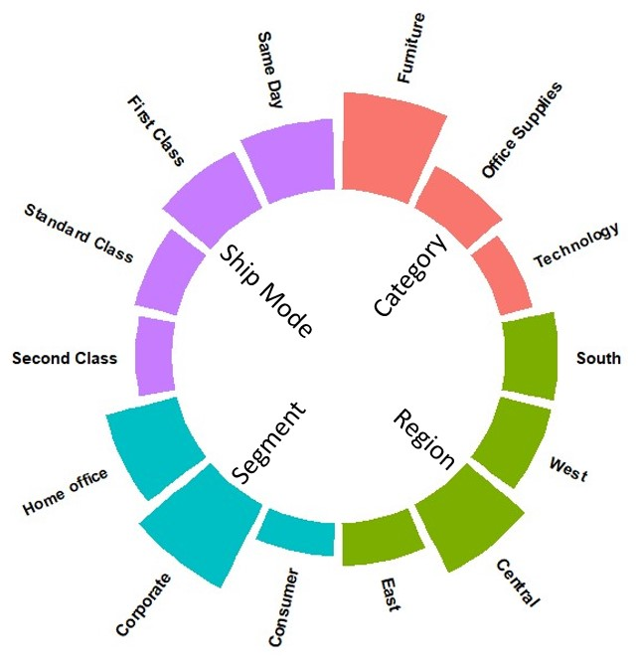
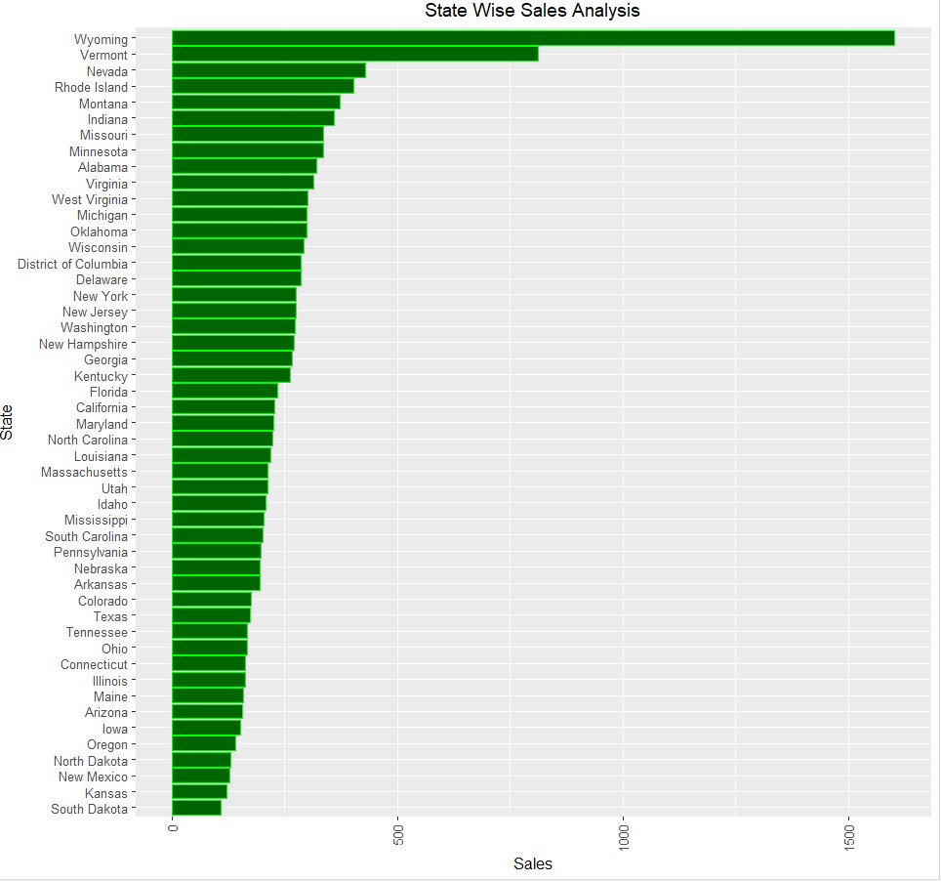
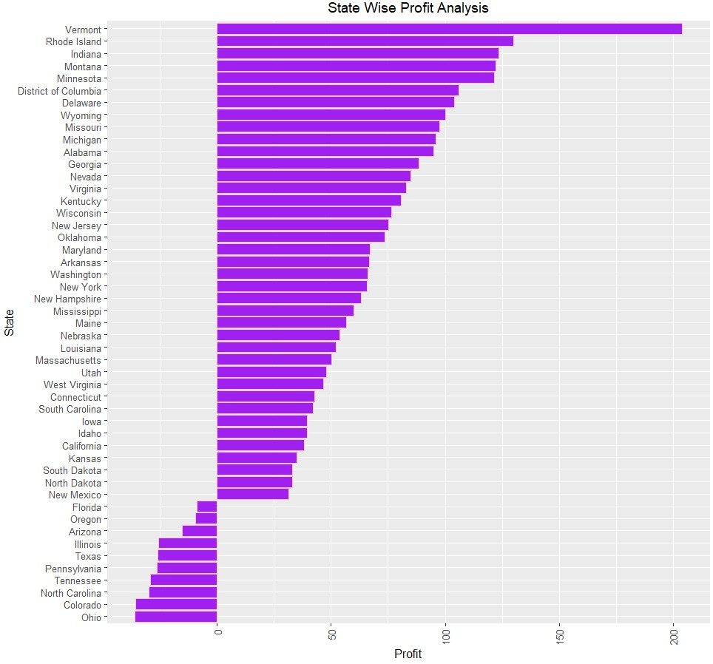
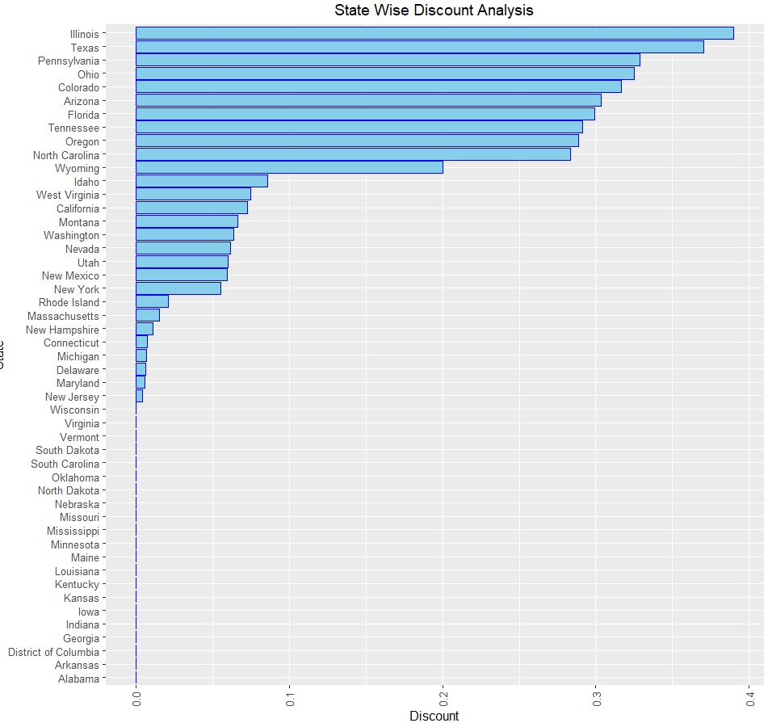
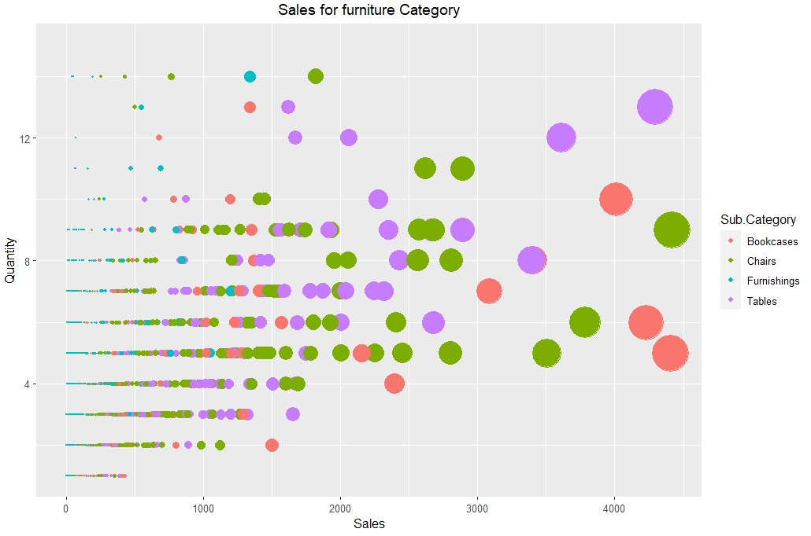
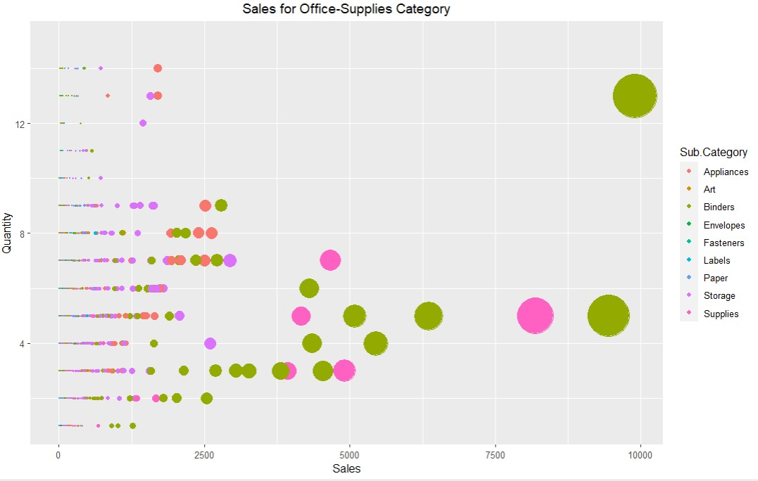
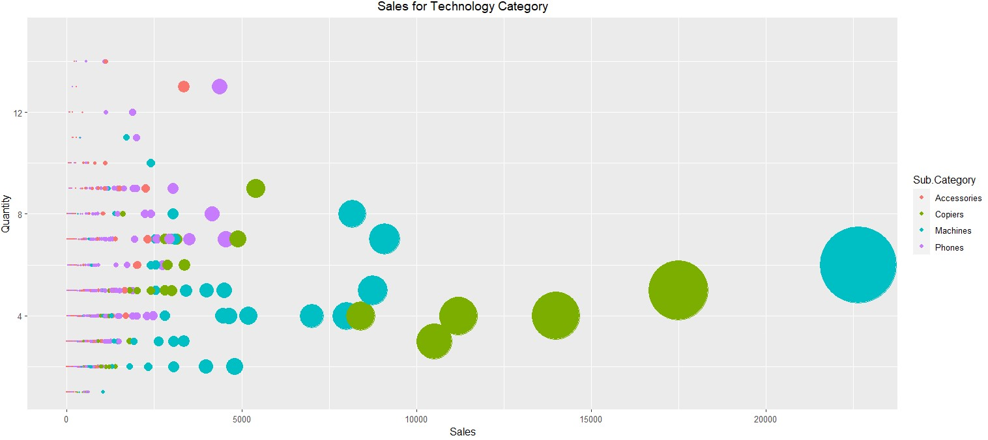
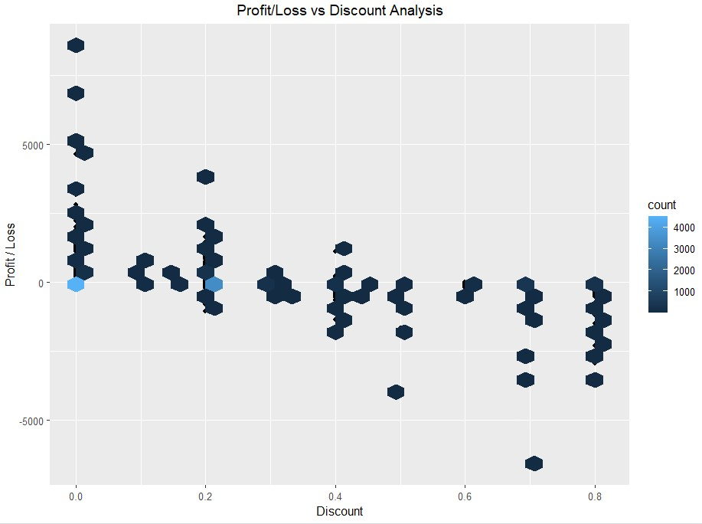
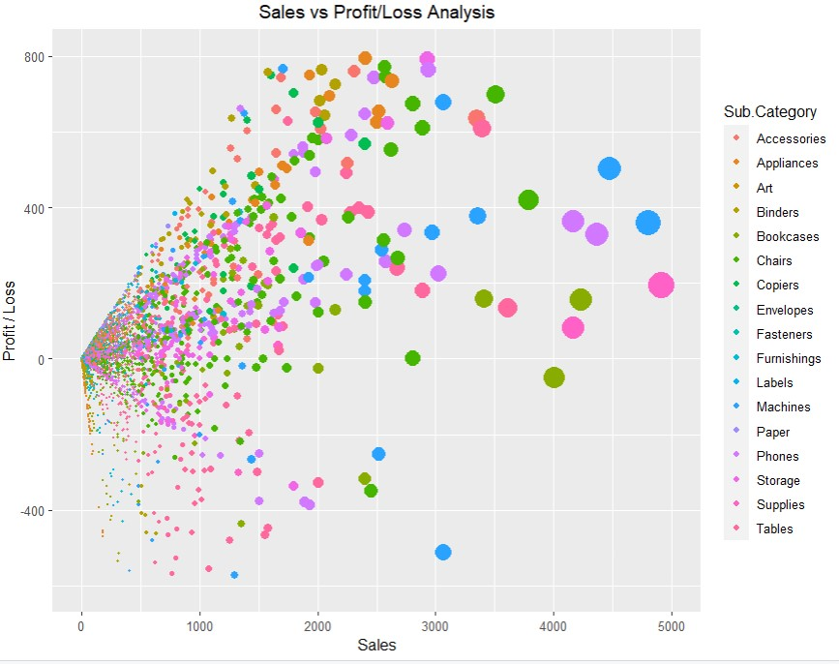
Superstore Sales
Hypothesis:
To scrutinize the sales of company, & check how different factors are affecting its sales.
To extract nuances required for increasing profits & minimizing losses.
Preferred Ship Mode:
Standard Class – Most Preferred
Second Class – Moderately Preferred
First Class – Less Preferred
Same Day – Least Preferred
asd
Category wise Expense:
Technology – Most expensive
Furniture – Moderately expensive
Office Supplies – Least expensive
State wise Sales:
California & New York, with highest sales & profits of around $80k, are our top 2 states.
Texas, Despite of having third highest sales is in loss. Probably, the reason might be its highest discount offers.
Product Category wise Sales:
Despite high sales, Tables & Bookcases suffer huge losses, due to higher discounts.
Office supplies grabbed highest profit margins.
With highest sales & profits, Copiers are profitable supported by low discounts.
Conclusion:
Due to high shipping costs of bulky furniture, it is less popular. Companies need to lower discounts to support it.
Technology, being most popular have highest sales.
Although with high profit margins, stores need to work on increasing office supply sales.
References:
https://r-graph-gallery.com/index.html
https://visme.co/blog/infographic-best-practices/
https://www.kaggle.com/

